Slide 1
LAB 3:Understand the BIOS and Installation
Deliverable To:Peter Wheeler
Deliverable By:Kulbir Singh Dhindsa
Gurinder Singh Kang

Slide 2
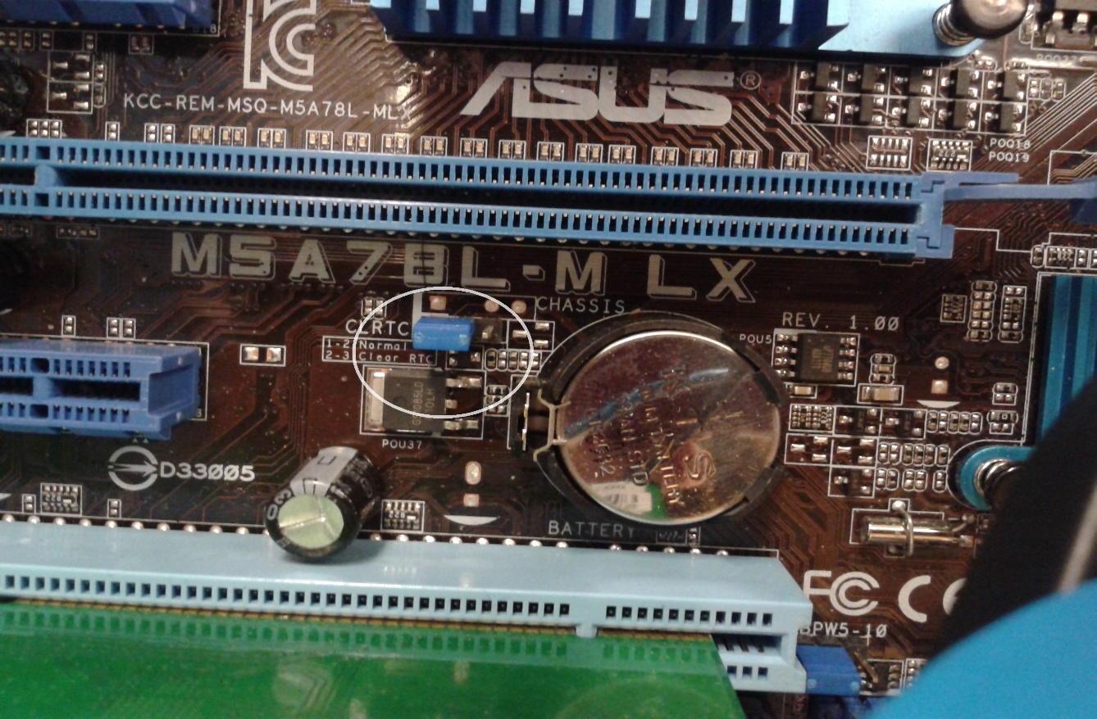
First we start our PC then pressing del key we get access to the BIOS. The password was already set so we directly locate the jumper and move it to the alternating pin settings and reset the jumper.

Slide 3
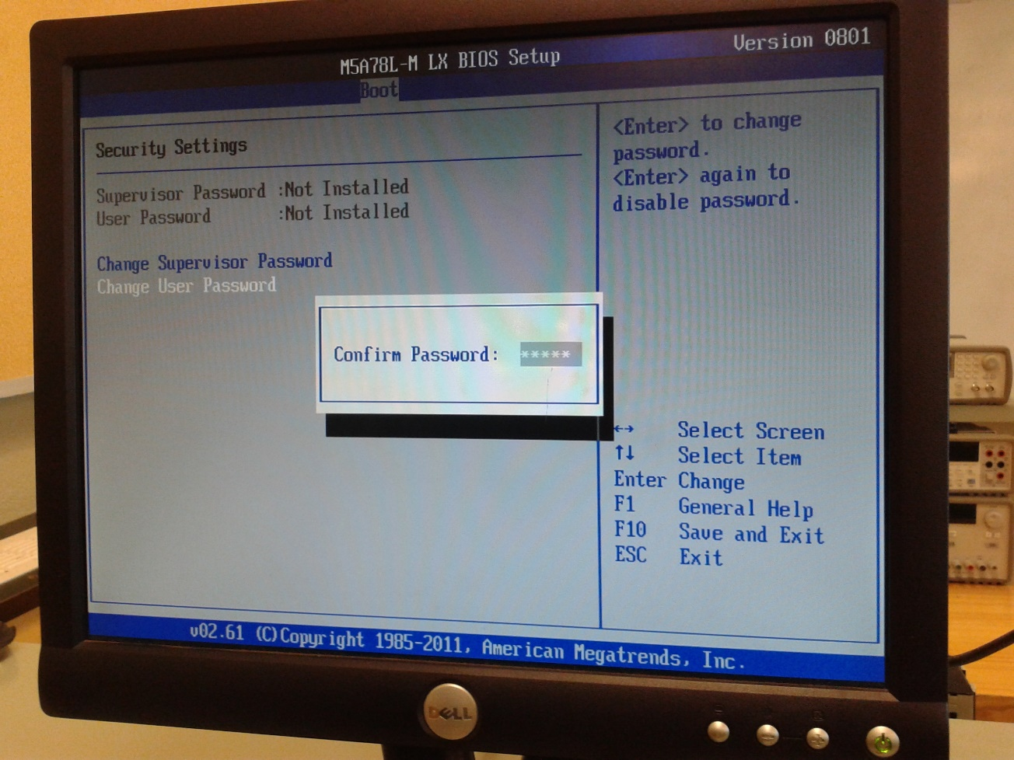
After that we again Turn on the machine and enter the BIOS and reset the password.

Slide 4
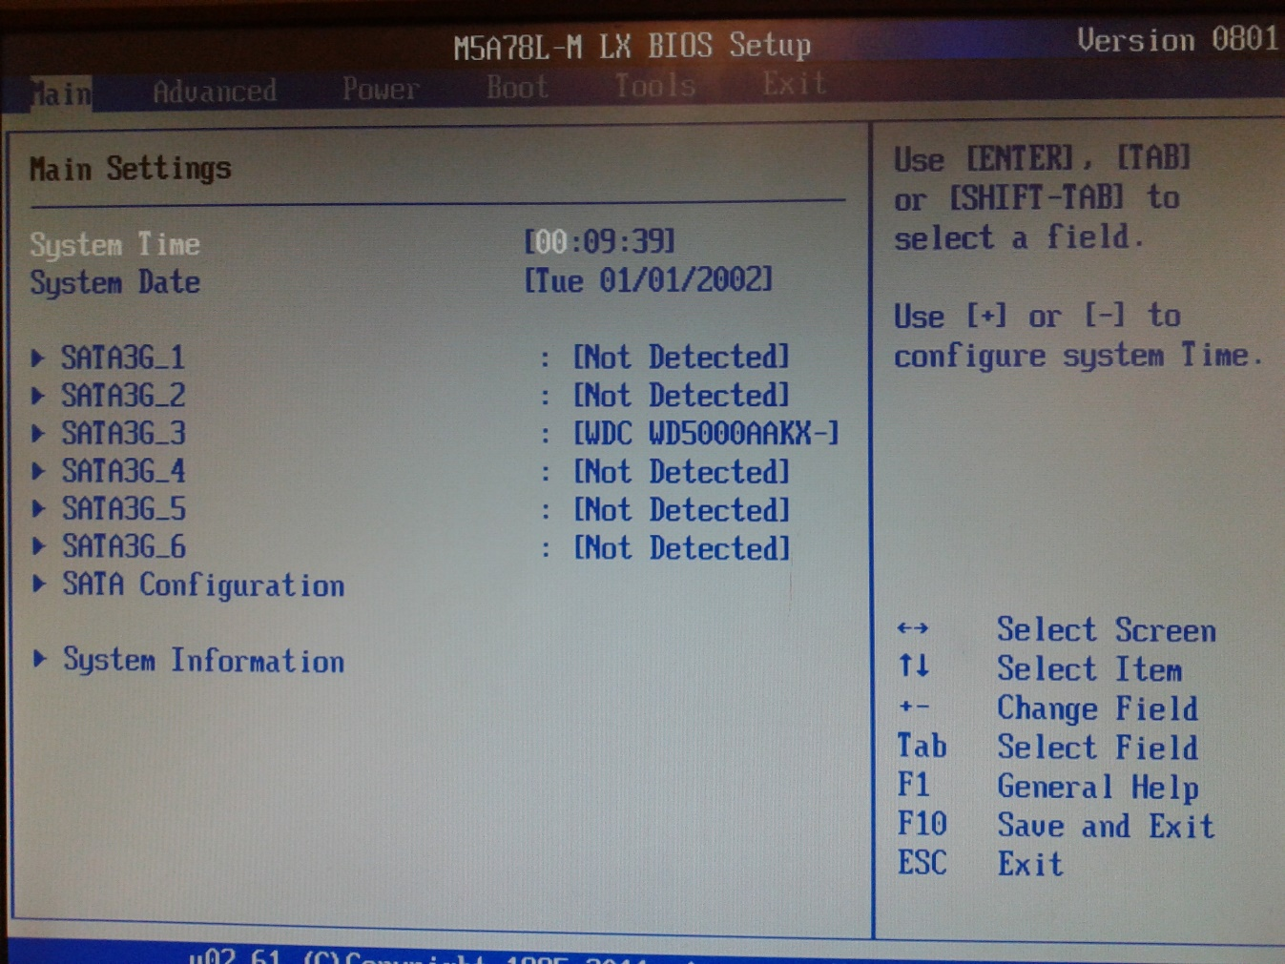
This is the by default Date and Timing.

Slide 5
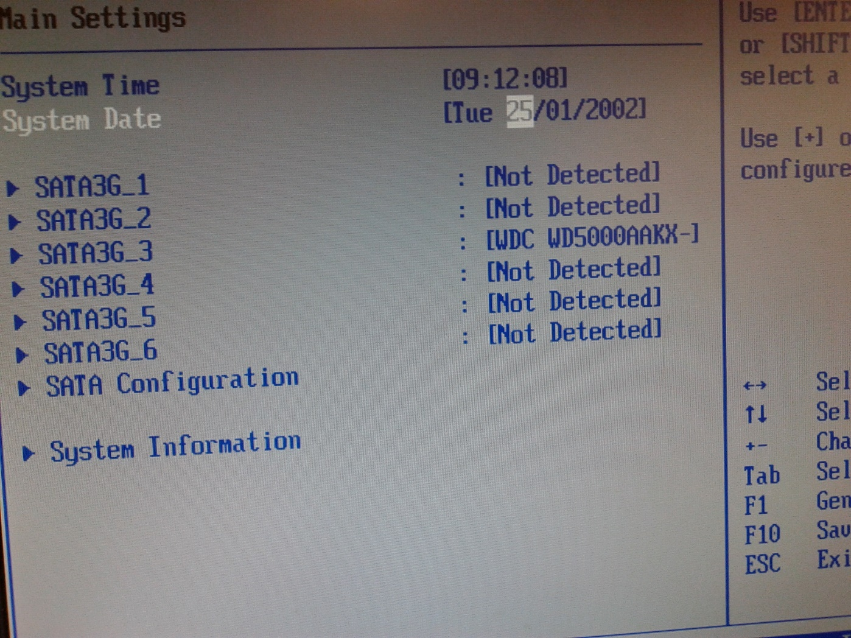
Here we reset the Date and Time.

Slide 6
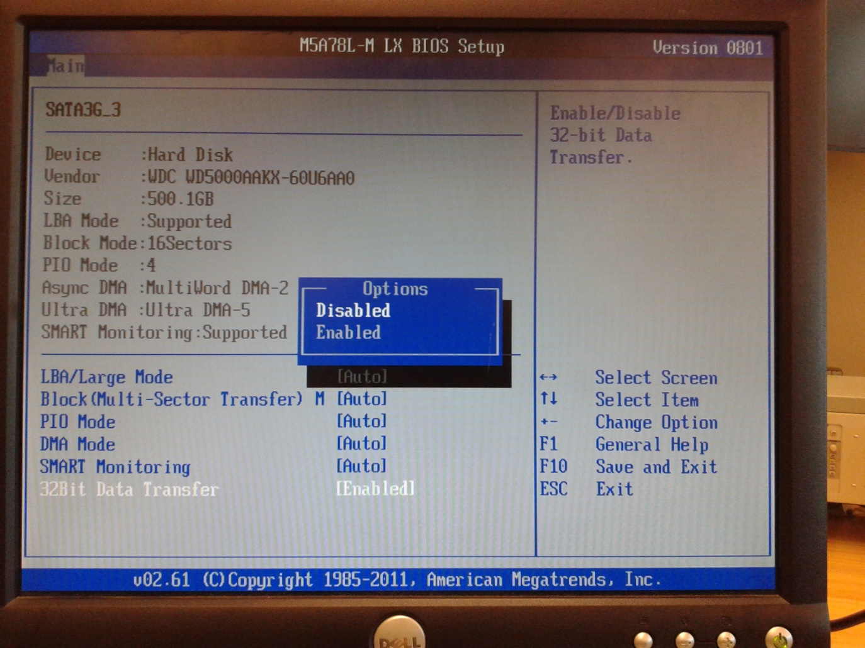
Here we disabled all the hard drives in BIOS and reboot the system.

Slide 7
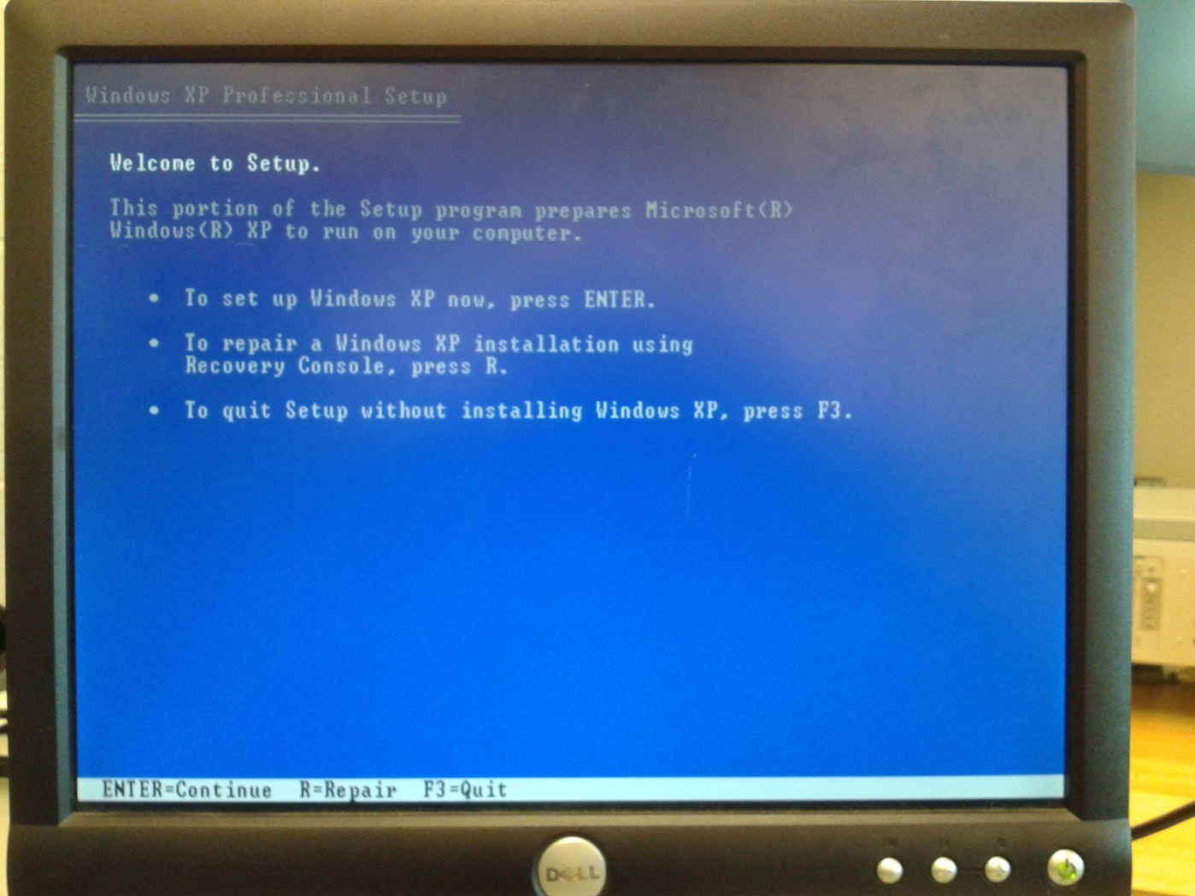
Installation of Window XP in PC

Slide 8
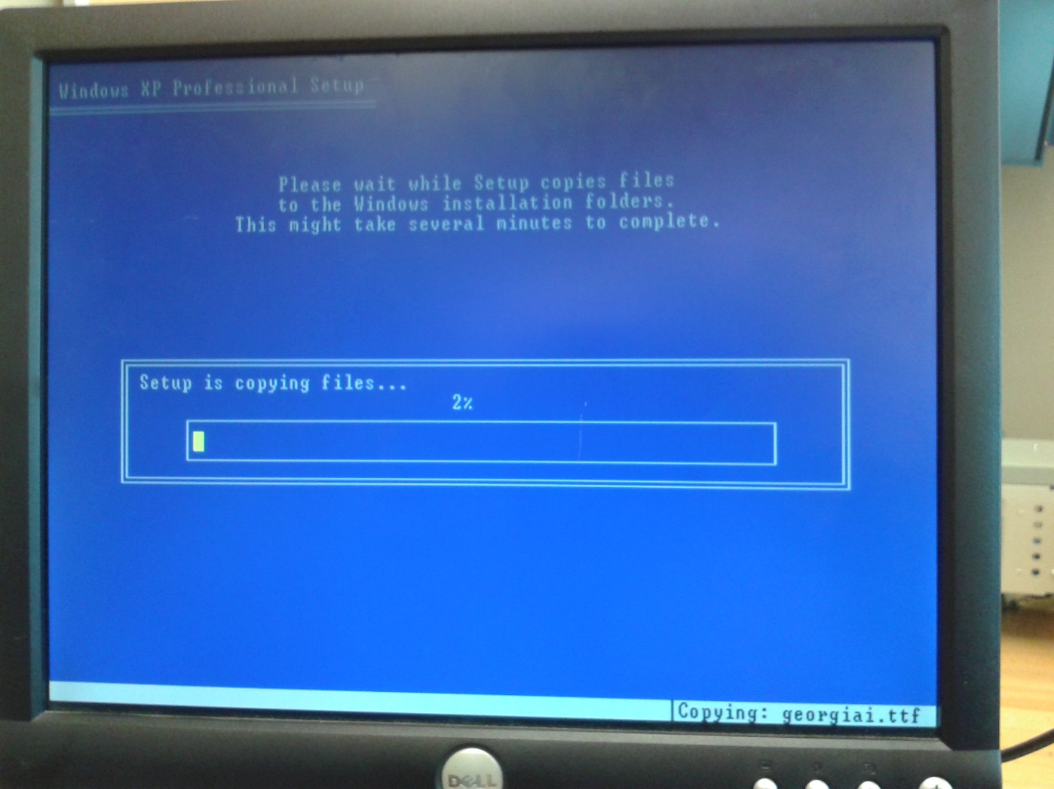
Partition of Window

Slide 9
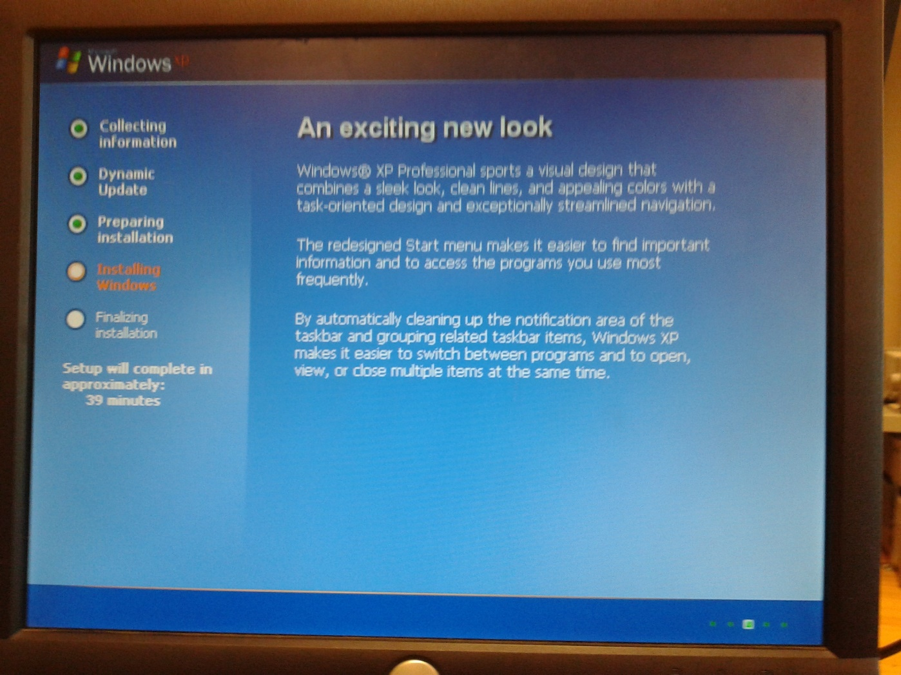
Installation process is running

Slide 10
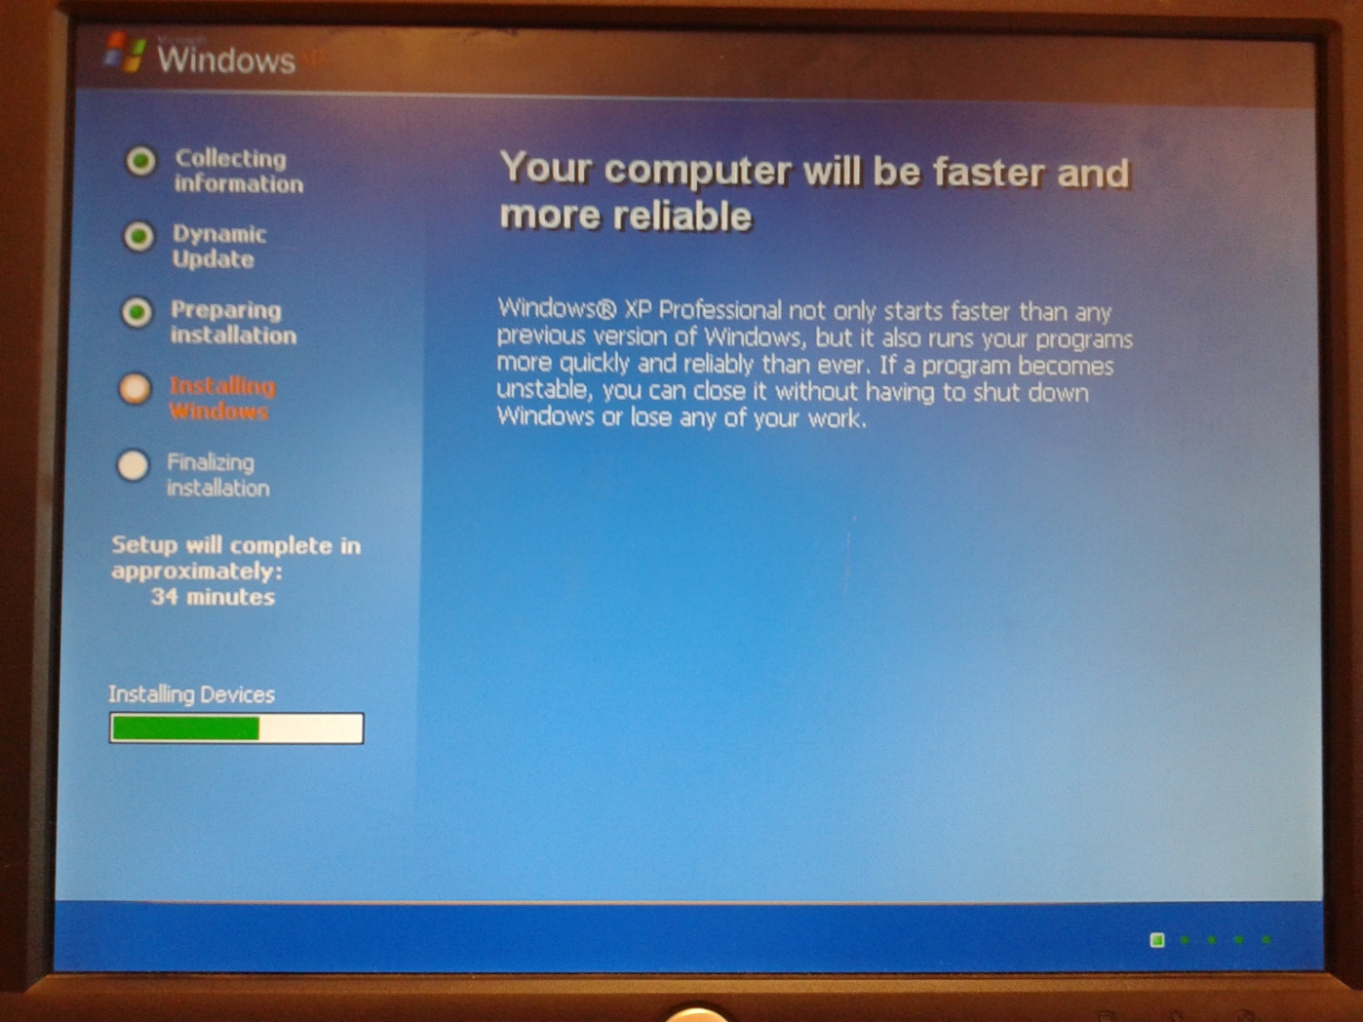
Finishing Installation

Slide 11
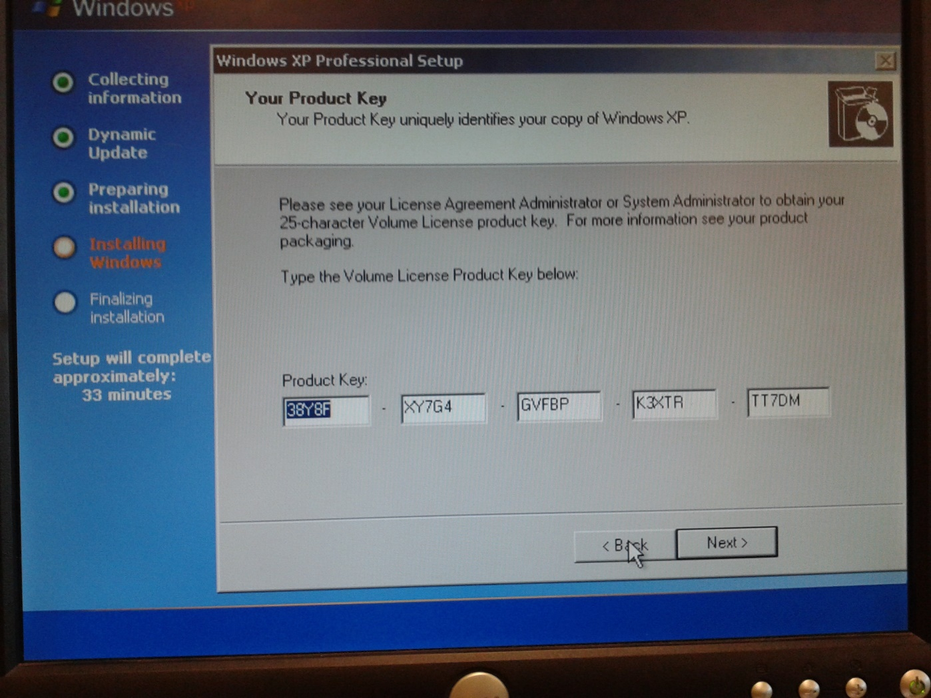
Entering the Product Key

Slide 12
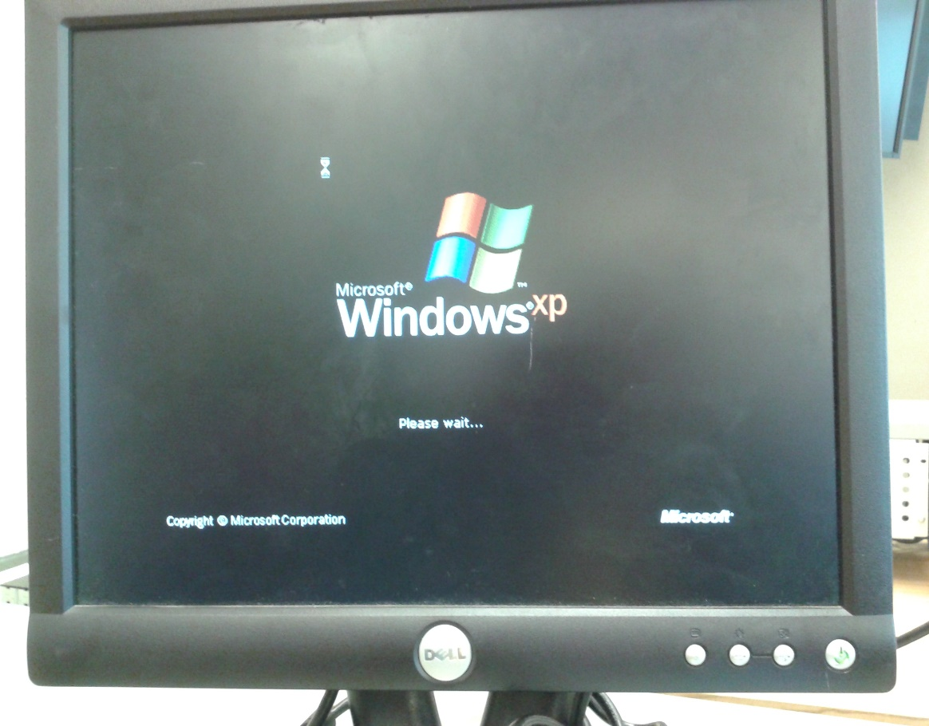
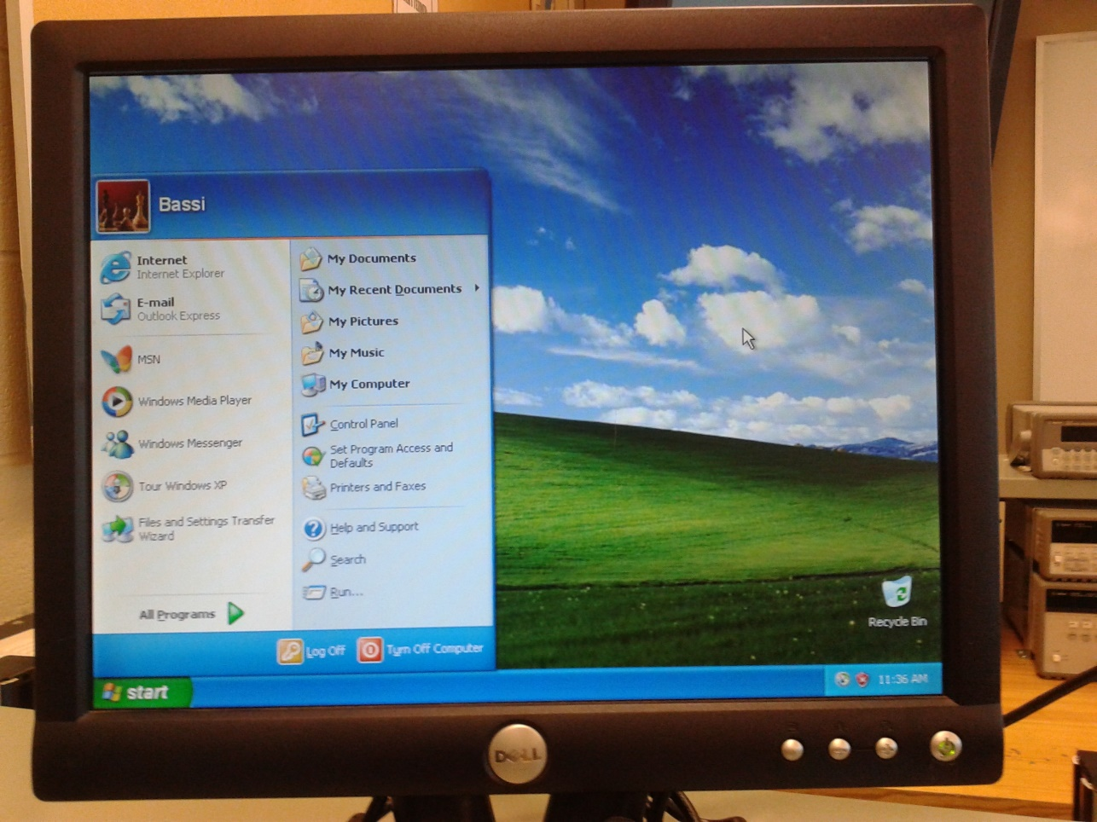
Installed Window XP

Slide 13
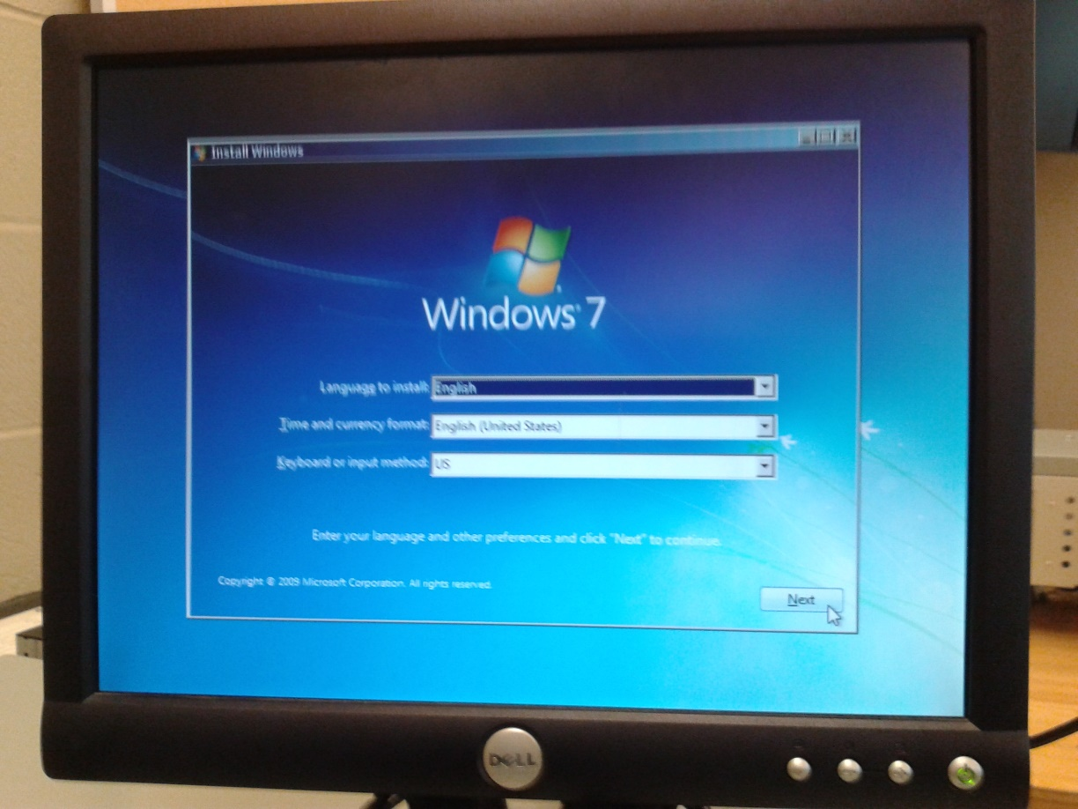
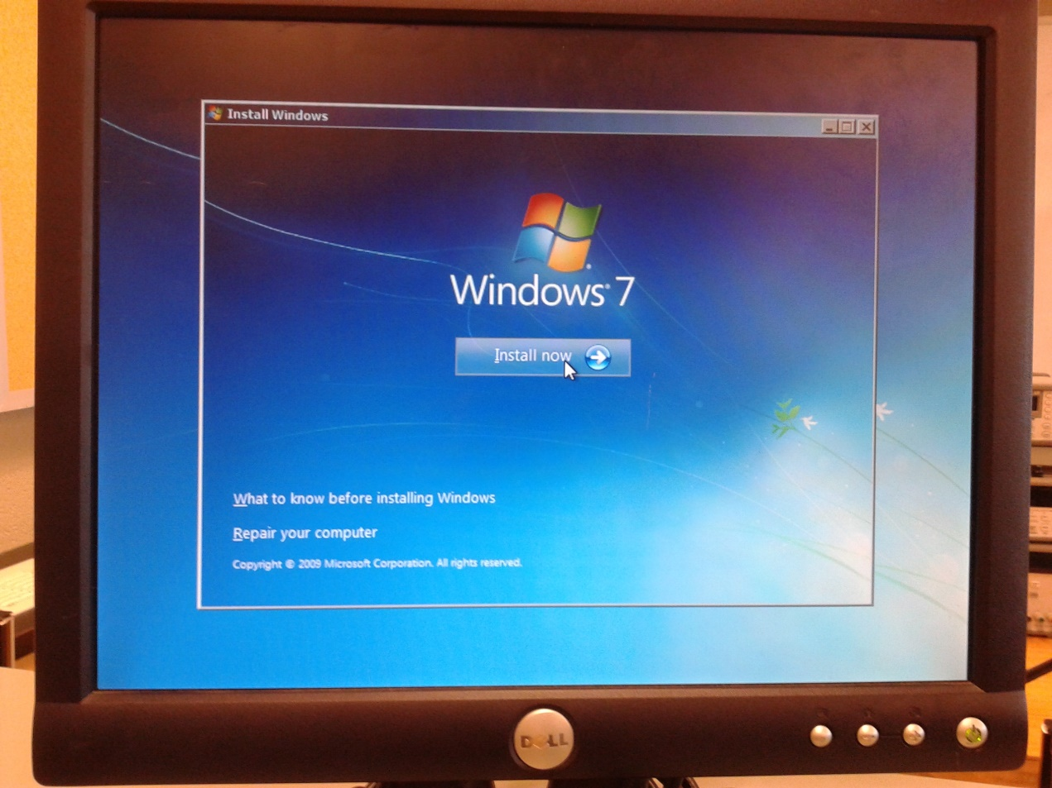
Installation of Window 7

Slide 14
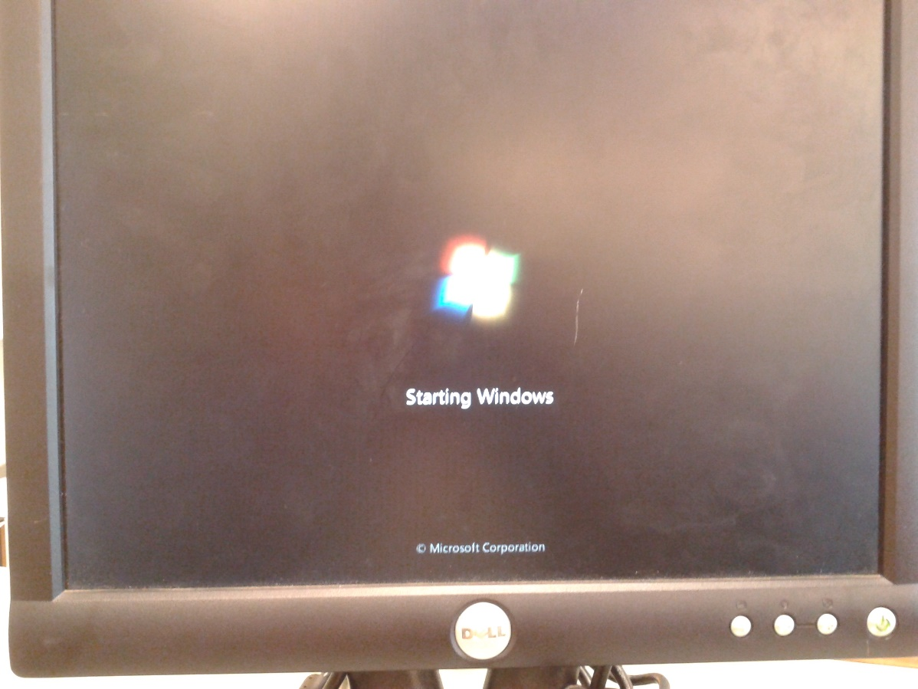
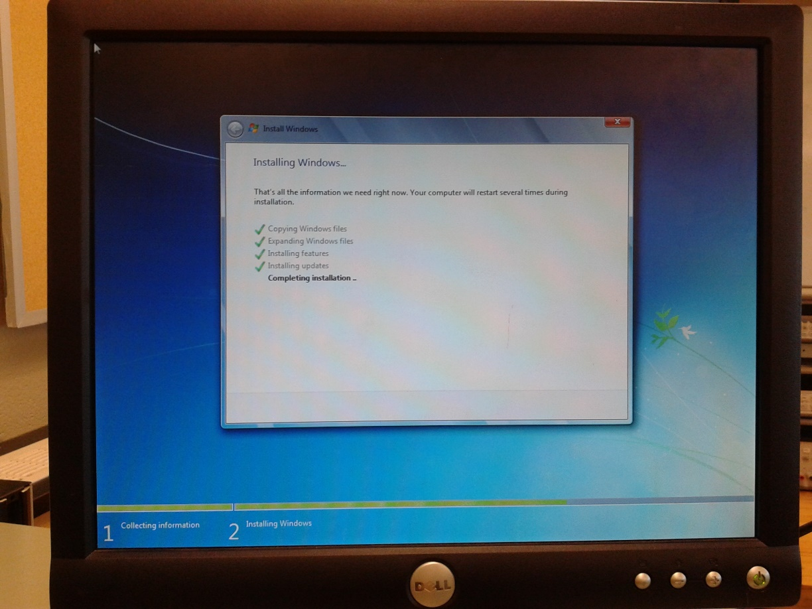

Slide 15
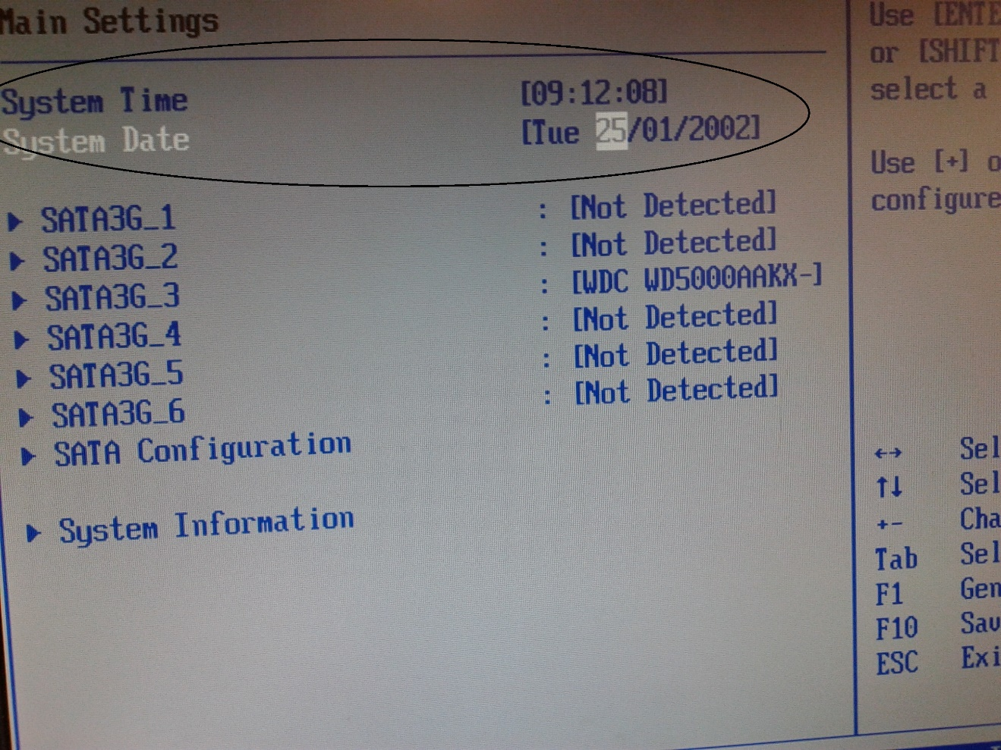
Q:- Upon reboot enter BIOS again and try changing any setting. Were you successful?
Ans – Yes

Slide 16
Q:- Now try changing settings. Were you successful?
Ans - Yes

Slide 17

Q:- Shut the machine down. Assume you forgot or don’t know the BIOS password. This would be hard to make changes since the password is needed to reset/change the password and make changes in the BIOS. Luckily there is a password reset jumper located on the main board. Locate this jumper and remove it or move it to the alternate pin setting (confirm with manual), then turn the power on. What happens?
Ans – When we remove jumper it does not need any password to change settings.

Slide 18
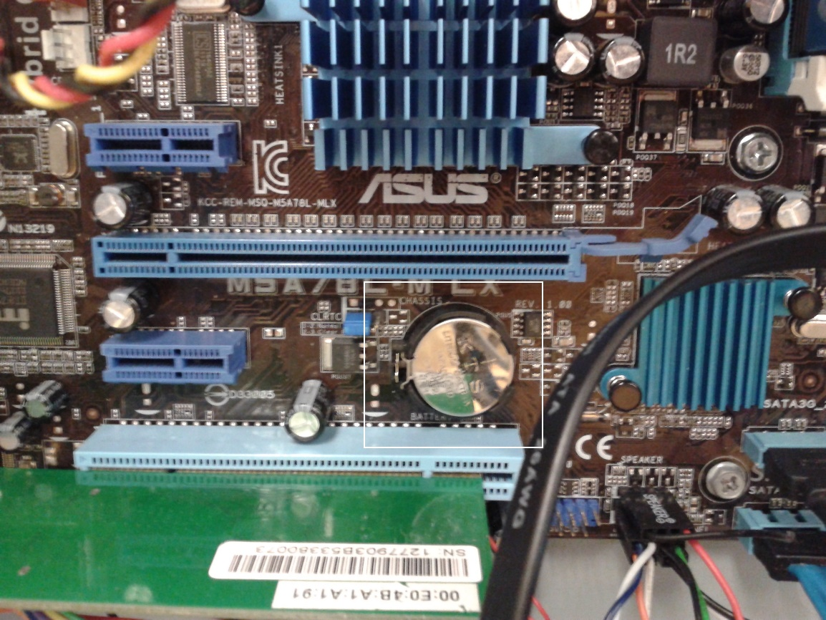
Q:- What other means do you have to reset the BIOS?
Ans- REMOVING JUMPPER
2)REMOVE CMOS BATTRY
3)REVERT TO FACTORY
DEFAULTS SETTINGS

Slide 19

Q:- Disable all hard drives in the BIOS and reboot the system. What do you think will happen?
Ans- Nothing is happened. Its shows
Hard drive is disabled.
What actually happens?
Ans-Nothing happened.

Slide 20
Q:- Insert an install a disc for your earliest version of a Windows OS in to the CD/DVD drive. Why install the oldest OS first?
Ans- Earliest versions of OS can’t recognize and backup the files to external storage.

Slide 21
Q:- Set the boot priority to have HDD ahead of the CD/DVD drive. What do you think will happen. When the machine boots?
Ans – when we set the boot priority to have HDD ahead of CD/DVD drive it reads the hard drive first rather than CD/DVD
What actually happens?
It read the hard drive after that CD/DVD

Slide 22
Q:- Set the CD/DVD drive to boot ahead of the HDD. What do you think will happen when the machine boots?
Ans- when we set the boot priority to have HDD ahead of CD/DVD drive it reads the hard drive first rather than CD/DVD
What actually happens?
It read the hard drive after that CD/DVD

